Slide 1
Software Testing Traceability Matrix​

Slide 2
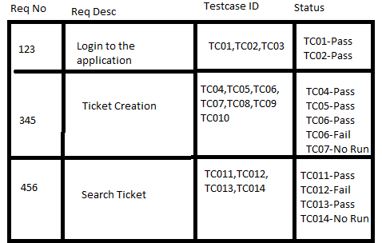
What is Traceability Matrix?
Traceability Matrix
Document that traces and maps the relationship between two baseline documents
One with the requirement specifications and another one with the test cases.

Slide 3
Main purpose of Traceability Matrix
Main purpose:
Validate that all requirements are checked via test cases
No functionality is unchecked during Software testing.

Slide 4
Parameters in Requirement Traceability Matrix
Parameters:
Requirement ID
Requirement Type and Description
Test Cases with Status

Slide 5
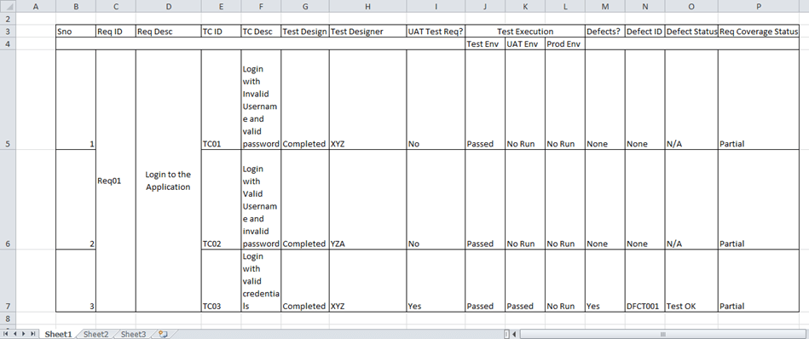
Parameters in Requirement Traceability Matrix
Parameters:
In a typical software testing project, the traceability matrix would have more than these parameters.

Slide 6
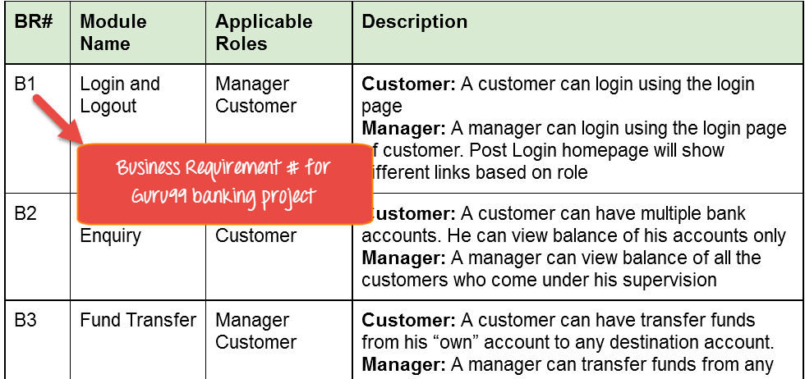
How to create Requirement Traceability Matrix
Business Requirement Document (BRD):
The customer should be able to login to banking website with the correct password and user#id while manager should be able to login to the website through customer login page.

Slide 7
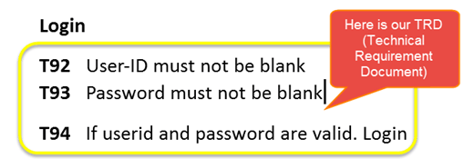
How to create Requirement Traceability Matrix
Technical Requirement Document (TRD):

Slide 8
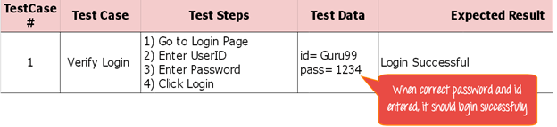
How to create Requirement Traceability Matrix
Step 1: Sample Test Case:
“Verify Login, when correct ID and Password is entered, it should log in successfully”.

Slide 9
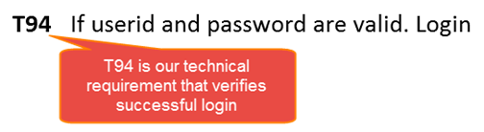
How to create Requirement Traceability Matrix
Step 2: Identify the Technical Requirement that this test case is verifying:
The technical requirement is T94 is being verified.successfully”.

Slide 10
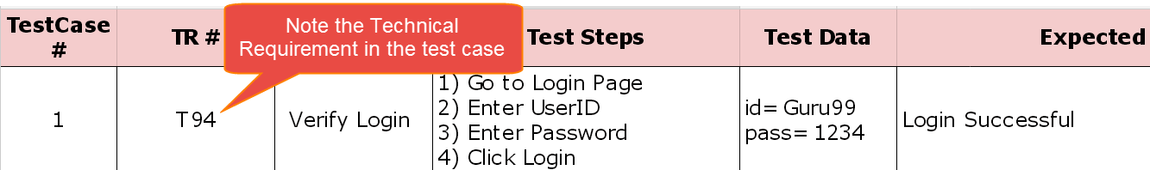
How to create Requirement Traceability Matrix
Step 3: Note this Technical Requirement (T94) in the Test Case

Slide 11
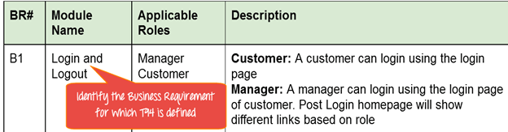
How to create Requirement Traceability Matrix
Step 4: Identify the Business Requirement for which this TR (Technical Requirement-T94) is defined

Slide 12
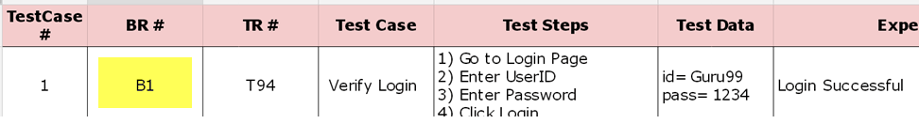
How to create Requirement Traceability Matrix
Step 5: Note the BR (Business Requirement) in Test Case

Slide 13
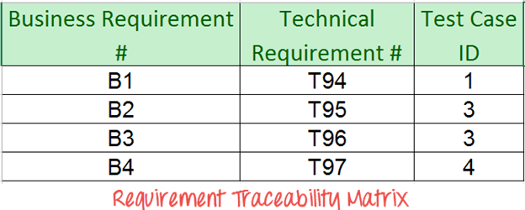
How to create Requirement Traceability Matrix
Step 6: Do above for all Test Cases. Later Extract the First 3 Columns from your Test Suite. RTM in testing is Ready!

Slide 14
Advantage of Requirement Traceability Matrix
Advantage:
It confirms 100% test coverage
It highlights any requirements missing or document inconsistencies
It shows the overall defects or execution status with a focus on business requirements

Slide 15
Thank You

